Slide 1
Presentation & Interaction Skills-I

Slide 2
Topics to be covered:
Public Speaking/Speech-Delivery
Group Discussion
Presentation Skills

Slide 3
Public Speaking/Speech Delivery:
Definition:
Public speaking is, simply, an oral presentation or speech delivered to a live audience. It is generally a formal or staged event.

Slide 4
Public Speaking: Choosing an appropriate pattern
Chronological Pattern: In this pattern, ideas are arranged keeping in mind the chronology of events. These speeches require a clear link to be established between the events and their time sequence . Ex. The History of Internet
Causal Pattern: The ideas are divided into two major components-causes and their effects. This pattern is chosen to highlight the relationship between a problem and the reasons for its existence. Ex. Global Warming
Spatial Pattern: Best suited to speeches which have a geographical or structural orientation. Ex. Amber Fort: Its structure and Splendour, Design of an Automatic Washing Machine

Slide 5
Contd.
Topical Pattern: This pattern chooses to divide and arrange the different parts of a speech into various headings and sub-headings. It is used when the speaker informs about the various kinds or types of something. Ex. Barriers in Listening
Psychological Pattern: At times, a situation requires the speaker to structure the speech according to the needs of his/her listeners. In this, the speaker arranges ideas in a manner most likely to create an immediate impact by using persuasion and emotion in style and sense. Ex. Loneliness: A By-product of Modern Living?

Slide 6
Public Speaking: Different methods
Speaking From Memory
Speaking impromptu
Speaking from the manuscript
Speaking from notes

Slide 7
Making speeches interesting and captivating:
Make your beginnings catchy.
Use humour and wit.
Use body language appropriately.
Employ proper voice modulation.
Use examples and instances.
End emphatically.

Slide 8
Group Discussion(GD)
A formal discussion which involves six to fifteen participants who sit in a group to discuss a topic or a case.
A methodology used by an organization to gauge whether a candidate possesses certain personality traits and/or skills that are desired of him/her.
The group members have to interpret, analyse and argue, so as to discuss the topic or case threadbare as a team.

Slide 9
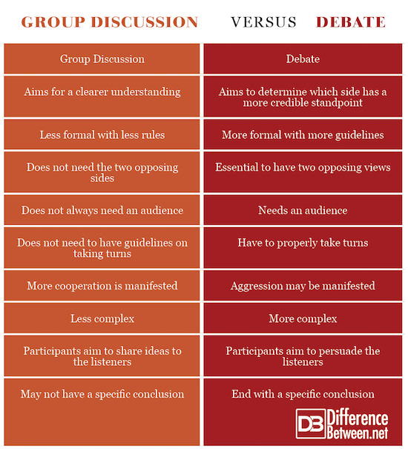

Slide 10
Steps in a Group Discussion
Announcement of the topic.
Preparation time(2-3 minutes)
Broaching the topic-The initiator has the responsibility of explaining the key words of the topic.
Contributing judiciously-All the participants need to give voice to their views by contributing at different stages.
Creating conducive environment-Invite participation, empathize.
Handling difficult situation-In case of a conflict, act as a mediator.
Closing effectively-Keep it brief and concise. Avoid raising new points. Include the major points discussed by the entire group.

Slide 11
Personality traits to be evaluated in a GD
Reasoning Ability
Present your ideas with proper reasoning and argument
Use facts to lend credence and conviction to your arguments
Leadership
It is never predefined. One emerges as a leader by displaying leadership qualities.
Leader facilitates discussion in a constructive manner, co-ordinates, motivates, and finally steers the conversation towards a goal.
Openness
Open to the ideas of others as well as to the evaluation of your own ideas

Slide 12
Contd.
Assertiveness
Put forth your ideas in a very emphatic, positive and confident manner.
Display positive body language, both while speaking and listening
Initiative
Initiate a GD only if you are well-versed with the topic.
Attentive Listening
Listen carefully to others when they present their ideas.
Incorporate the inputs of others to build your points .
Introduce the topic with clarity and add a quote, fact or question to it and make it appealing accordingly.

Slide 13
Presentation:
Making a presentation is a way of communicating your thoughts and ideas to an audience.
Effective presentation skills is an important tool to build your career.
Skills to be a good presenter can be developed with preparation and practice.

Slide 14
Pre-Presentation Preparation : Audience Analysis
Audience analysis involves identifying the audience and adapting a speech/presentation to their interests, level of understanding, attitudes etc.
Important points:
Know your audience-group size, demographics.
What does the audience want?
What does the audience already know?
What does the audience need to know?
What does the audience expect from this presentation?
How will the audience benefit from this presentation?

Slide 15
Developing Presentations
PLAN:
Analyze the situation-Define your purpose(to inform, to persuade, etc) as per the audience analysis.
Gather information: Obtain the relevant information to achieve your purpose.
Select the right medium-Choose the best medium or combination of media like ppt, handouts.
Organize the information: Define your main idea, limit your scope and verify timing, select a direct or indirect approach and outline your content.

Slide 16
COMPOSE
Introduction:
Arousing Audience Interest: Announce the topic, share an anecdote, Ask a question, state a startling statistic, Use humour.
Building your credibility: Your introduction has to establish your credibility in the subject of the presentation.
Previewing your presentation: Provide a preview of what’s ahead, helping the audience understand the structure, main idea and major supporting points.

Slide 17
Main Body: The body of the presentation should meet the promises of purpose and information made in the introduction.
The main points should be brought out one by one, with concise and relevant supportive evidence, statistics or examples and verbal ‘signposting’ of your progress through your argument or report.
You could present each important idea or point several times in different ways, because a listening audience needs several opportunities to fully absorb meaning.
You need to state clearly the links between your ideas and always signal when the next point is coming. If you think something is particularly important, say so and why.

Slide 18
Conclusion:
Signal the end of your talk is coming. Remind the audience again of the topic.
Remind the audience of your argument, findings.
Offer an innovative, provoking thought to take away from this presentation.
Signal the end of your talk.
Signal the question/discussion session.

Slide 19
Visual Aids
Use of visual aids adds quality to your presentation.
Since more sensory perceptions are put to use, the audience will have greater retention of information.
Types:
PowerPoint
Posters
Flip charts
Handouts
Videos …..

Slide 20
Delivering an effective presentation:
Make a good set of notes you can follow at a glance, and PRACTICE your presentation.
Dress for the occasion and tidy yourself up.
Check the operation of audiovisual equipment before your presentation. Have a backup plan in case it fails.
Talk to your listeners as if you are having a conversation with them.
Avoid merely reading your presentation.
Use body language that shows CONFIDENCE! Smile and make eye contact with your Audience
Take time to think during your presentation! People have a tendency to speak more quickly under pressure. Make an effort to slow your pace and include pauses.
Use your Voice Effectively. Varying the speed at which you talk, and emphasizing changes in pitch and tone all help to make your voice more interesting and hold your audience’s attention.
PRACTICE is the Key

Slide 21
Questions:
A Group Discussion is
A. Communication of Ideas B. Constructive and Cooperative C. Both D. None
Public speaking without preparation is known as ____________
To whom should a presentation be aimed?
A. The highest authority in the room, regardless of where they are B. The entire audience
C. The people in the closest rows D. Your best friend in the room
Give an opening statement for the following topic of GD:
Mobile phones are necessary evils today

Slide 22
References
S. Kumar and Pushp Lata, Communication Skills, Oxford University Press,1st, Ed. 2011
Raman M. and P. Singh, Business Communication: Principles & Practices, 9th Impression, Oxford University Press, 2008
Bovee L C, Thill.J.V and Chaturvedi, M, Business Communication Today, 9th Edition, Pearson,2011
http://www.differencebetween.net/language/difference-between-group-discussion-and-debate/
https://carey.jhu.edu/uploads/files/Presentation_Skills.pdf
https://www.comm.pitt.edu/oral-comm-lab/audience-analysis
https://www.uts.edu.au/current-students/support/helps/self-help-resources/presentation-skills/structure-presentation

